Slide 1
The Impact of Statistical Word Alignment Quality and Structure in Phrase-based Statistical Machine Translation
A doctoral dissertation by:
Francisco Guzmán
CS Department
Tecnológico de Monterrey
Notes:
Good Morning!
My name is Francisco…
And today I’m going to talk you about
The research I’ve done for my dissertation
Intitled The Impact of Statistical Word Alignment.

Slide 2


In a world of increasing information …
Information on the Internet growing exponentially!
More content: News, blogs, status updates, tweets, etc.
Notes:
We live in an era where
More content is created every second:
From news, status updates, tweets.

Slide 3

… and many languages …
4000-5000 different languages in the world
Access to information is limited by language barrier.
Notes:
But the access to this information is limited
By the languages we can read/speak

Slide 4
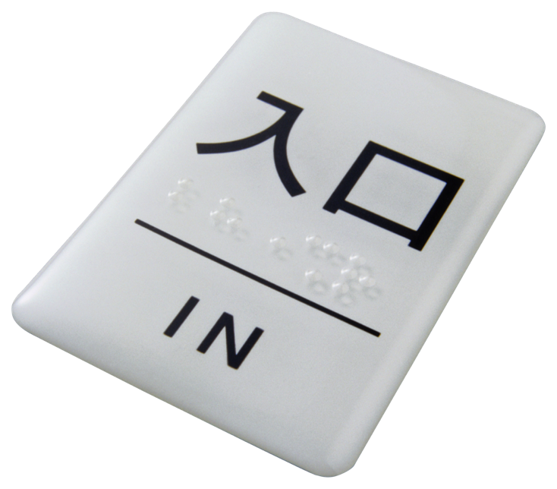
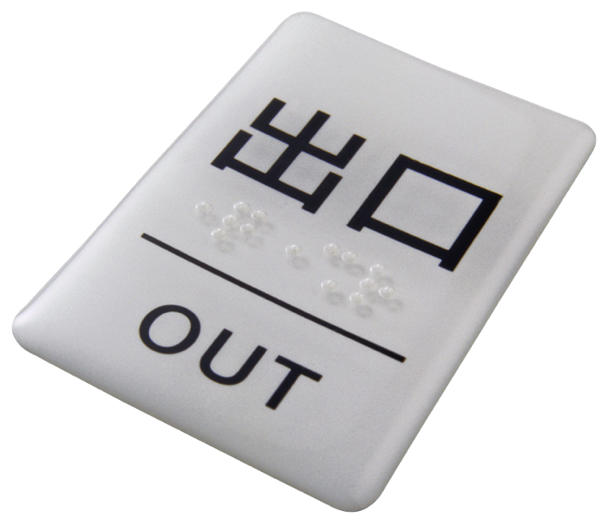
… we need Machine Translation
as a quick and cheap mean to perform translation.
Notes:
And that represents a problem of equal information access
That’s why we need Machine Translation
As a quick and cheap way to perform translation

Slide 5

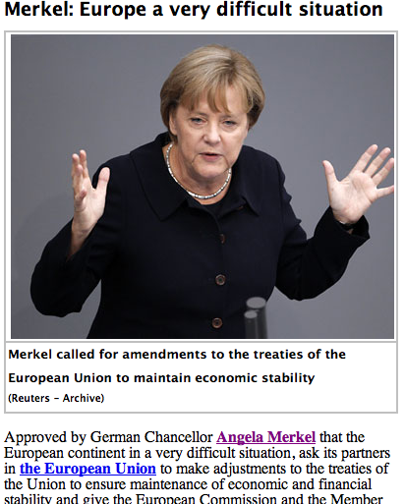
Pop quiz: what is she saying?
Options
A) I had a big sandwich for lunch
B) I’ve had enough with Greece’s Papandreu
C) We have a huge problem with European debt
D) Europe is in a very difficult situation
Notes:
So, question,
Who in the audience can read Arabic?
What do you think she’s saying?
Raise your hand if you think that A)
B)
….
Well the answer is D.
And we know that because we’ve used MT to translate this news article

Slide 6
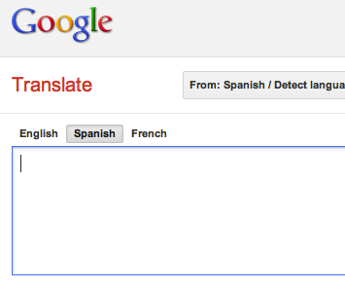
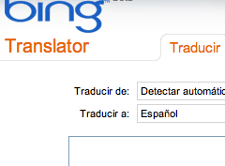
Online translators are examples …
Notes:
Many of you are familiar with the translation engines available online.
They are a good example of Machine Translation systems

Slide 7
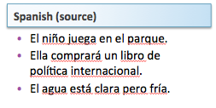
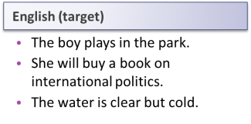
… of Machine Translation …
Notes:
Machine Translation is the task of translating text in one SOURCE natural language
(say Spanish)
Into a TARGET natural language (i.e. English)
For example, here we have a couple of sentences in our source language
El niño juega en el parque… etc
And we use a computer to automatically translate them into the target language
Resulting in
The boy plays in the park.
----- Meeting Notes (11/22/11 00:14) -----
typo

Slide 8
… that use statistical methods …
Machine Translation
Statistical
Rule-based
Example-based
Started in 80’s (IBM Candide).
Statistical Analysis of bilingual texts.
Not bound to source/target language.
Has proven to be very eﬀective.
As long as we have enough training data.
Notes:
Now, many of the translators online use Statistical Machine Translation.
It’s one of the several types of MT paradigms
But became very popular in the late 80’s, early 90’s.
Because it does not require complex linguistic rules,
Rather is based on statistical analysis f bilingual texts.
Thus, it’s not bounded to a specific source language target. And it’s very effective (as long as we have enough training data)

Slide 9
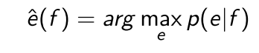
… to get the best translation
Model the probability of a source language
sentence f of being translated into target
language sentence e
Notes:
Statistical Machine translation models the probability of a sentence F:
Of being the translation of a sentence E.
The decision rule maximizes that probability. Thus, We want to obtain the translation in English E that maximizes the probability of
F being translated into E.

Slide 10
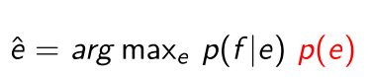
… to get the best translation
Language Model
Translation Model
Decoder
Translation
Language Model = fluency
Translation Model = fidelity
Decoder = search for optimal
Notes:
Using a the bayes rule, we can rewrite the first rule, into:
Which is known as the noisy channel model.
And it’s broken into three parts.
The language models, which gives fluency. I.e. how good “English” the translation is.
The translation model, which gives the fidelity. Or how good the translation E represents the original meaning of F
And the decoder, which is in charge of giving us the optimal translation.

Slide 11

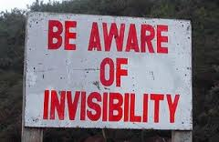
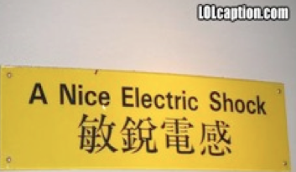
Yet better translators are necessary
Google Music competirá con la tienda dominante, iTunes de Apple, y otros servicios digitales de música.
La tienda de Google venderá canciones por un precio estimado a un dólar la canción, informó el Wall Street Journal.
Google Music Store to compete with dominant, Apple iTunes and other digital music services.
Google's store sold songs for an estimated price for a dollar a song, the Wall Street Journal.
Notes:
All that said, Machine Translation has come a long way since its beginnings,
Now a days, pretty accurate translations can be obtained for certain language pairs.
But, things aren’t perfect and there is still a long way to go.

Slide 12

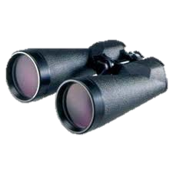
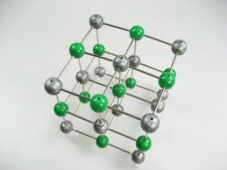

This is a story

Slide 13
This talk outline:
0 -Motivation
3- The translation model and translation quality.
1- Word Alignments and SMT
· Quality discrepancy
· Partial explanations
· Hypothesis and objectives
4- Improving SMT using alignment structure
2- Alignments and the translation model
Conclusions
Notes:
Today, we will talk about a specific problem of Machine Translation.
Namely, the discrepancy between what is known as Alignment Quality and its cousin Translation Quality.
We will introduce related work, that has tried to address this problems
And we will introduce out hypothesis and the set of objectives for this dissertation
Next, we’ll have a closer look at the effect of alignments and the translation model
Followed by the effects of the translation model and tq
In the last part, we will propose several alternatives to improve machine translation using alignemtn structure
Finally we will provide a set of conclusions.

Slide 14
Word Alignments
Je ne bois pas du lait
veux
I don’t drink milk
want
And Phrase-based SMT
Notes:
So let’s talk about word alignments

Slide 15
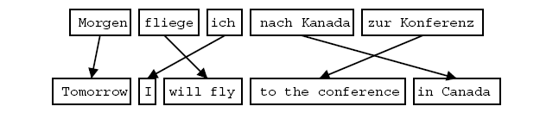
Phrase-Based SMT …
Phrases are chunks of words.
The idea is that phrases move as units during the translation process.
Phrases capture some contextual information.
There is much less reordering to do.
Notes:
Before I talked about SMT, and its parts: Language Model, Translation Model and decoder.
Well current state of the art translation involves a translation model that is based on phrases.
Here, the idea is that translation units are chunks of words,
As such, some contextual information is preserved during translation,
And there is less reordering to do compared to word by word translation.

Slide 16
… is based on word alignments.
Preprocessing
Word Alignments
Phrase Extraction
Translation Model
Notes:
Now, here are the basic steps for obtaining a translation model from our training data.
First, we do some kind of preprocessing, to eliminate unwanted noise.
Then we obtain word alignments (word-to-word translations)
Then we obtain phrase-pairs (higher order chunks of words)
That we consolidate into our translation model.

Slide 17
Word Alignments …
Represent word-to-word (lexical) translations
La casa es blanca
Je ne veux pas du lait
The house is white
I don’t want milk
Notes:
Word alignments represent lexical translations.
For instance black box, A word alignment between La casa es blanca, and the house is white.
On green, we observe the ‘alignment links’ which correspond to word tranlations.
On the white box, we observe another example.
Je ne bois pas du lai
Vs
I don’t drink milk.

Slide 18
… are important …
Preprocessing
Word Alignments
Phrase Extraction
Translation Model
How phrases are extracted (which ones, how many, etc).
How phrases are scored.
Certain features (lexical).

Slide 19
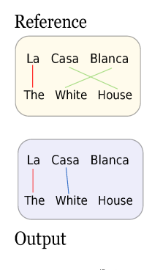
… increasing its quality …
There are three basic quantities that we can measure:
true positives (tp) (matches)
false positives (fp) or error type I
false negatives (fn) or error type II
There are several metrics to measure the alignment quality
Precision
Recall
F-score
AER (Alignment Error Rate)
Tp: 1
Fn:2
Fp: 1
Notes:
Alignment quality has been defined as defined as how close the statistical word alignment
Is to the human reference
There are three quantities we can measure. True, FalseP and FN.
Metrics are precision, Recall and the F-score.

Slide 20
.. has promoted developments …
Concern about improving alignment quality.
The recent availability of human annotated data.
Development of discriminative approaches, that use alignment quality as tuning metric. Moore (2005); Taskar et al. (2005); Blunsom and Cohn (2006); Niehues and Vogel (2008)
Under the presumption that better alignments meant better translations.
Notes:
Given the importance of alignemnts,
Concern about improving quality
Resulting in several discriminative approaches.

Slide 21
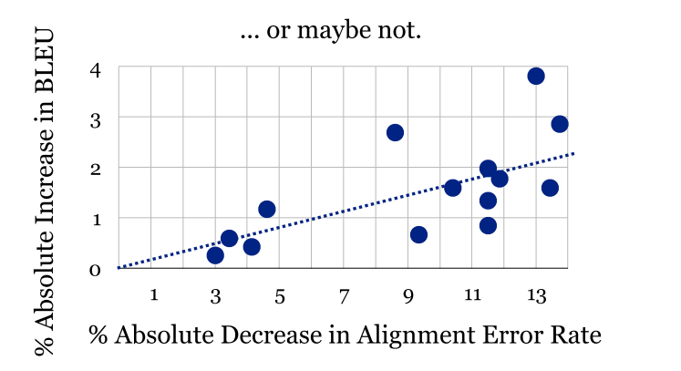
… to improve translation?
Despite the improvements in alignment quality,
Translation quality improvements remained small.
Some studies started to look into this phenomenon.
Lopez and Resnik, 2006

Slide 22
Looking into detail …
Alignment Quality vs Translation Quality
Fraser and Marcu (2006)
Vilar et al. (2006)
Alignment Quality vs Translation Pipeline
Lopez et al. (2006)
Ayan and Dorr (2006)
Alignment Structure vs Translation
Lambert et al. (2009,2010)
Guzman et al. (2009)
Notes:
----- Meeting Notes (11/22/11 00:14) -----
guzman?

Slide 23
… the performance mismatch
Translation Performance achieved by automatic metrics by comparing to a set of references.
Bi Lingual Evaluation Understudy (BLEU) (widely used)
Alignment Performance obtained by comparing to a human generated reference
Alignment Error Rate (AER) and F-measure (widely used)

Slide 24
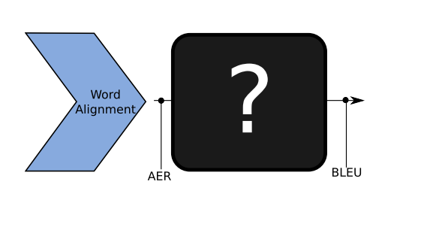
Alignment Quality vs. Translation

Slide 25
AQ vs TQ
It is important to have better alignment metrics
Fraser and Marcu (2007)
Evaluated correlation between BLEU and AER.
Variation of F-measure, balance precision, recall.
Vilar and Ney (2006)
Better BLEU scores can be obtained with “degraded” alignments.
Mismatch between alignment and translation models.
Metrics fail because no structure.
AER != BLEU
We need to regard not only alignment quality but also structure
v AER = ^ BLEU

Slide 26
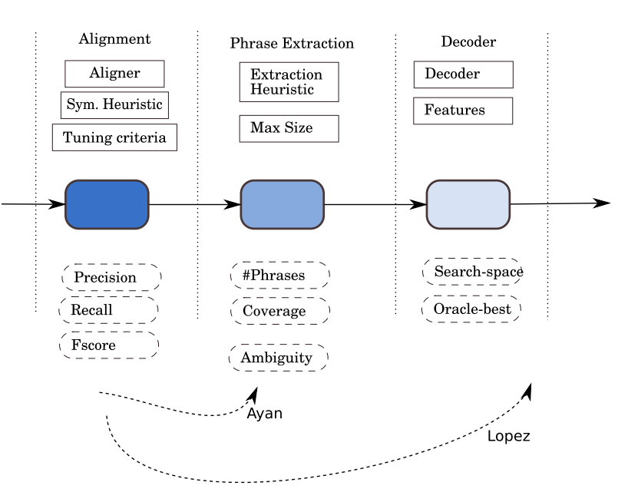
Alignment Quality in the Pipeline

Slide 27
AQ vs the pipeline
We have to study the effects of alignments on the Translation Model
Ayan and Dorr (2006)
Analyze the quality of the alignments and resulting phrase tables.
In-depth analysis of phrase table coverage.
Lopez and Resnik (2006)
Compare effect of different alignments in decoding.
Analyze variations in the decoder search space due to variations in alignment quality.
We need better feature engineering.
Notes:
----- Meeting Notes (11/22/11 00:14) -----
mejorar

Slide 28
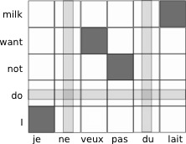
Alignment Structure vs. Pipeline
Je ne veux pas du lait
I don’t want milk
Links
SourceGaps
Crossings
Diagonality
Target Gaps
Notes:
----- Meeting Notes (11/10/11 13:25) -----
imagen

Slide 29
AS vs the pipeline
If we study alignment structure we find interesting relationships
Lambert et al. (2009, 2010)
Effect of Number of Links in phrase table size and ambiguity.
Analysis of link length, crossings, etc.
Bivariate correlation analysis.

Slide 30
The story behind …
We have to study the effects of alignments on the Translation Model
We need to regard not only alignment quality but also structure
If we study alignment structure we find interesting relationships
It is important to have better alignment metrics
We need better feature engineering.

Slide 31
… what we need to build …
More inclusive analysis
Using quality AND structure.
Several training stages involved.
Multivariate approach.
Predictive models
Identify most relevant variables.
Help us to design better features.

Slide 32
… our hypothesis …
Alignment structure has a large impact on how a translation model is estimated. Hence, it should also have a large impact on Machine Translation performance. Thus, by controlling the impact of alignment structure we will be able to improve Machine Translation performance.

Slide 33
… which lead to objectives …
Analyze the impact of alignment structure at different stages of the training pipeline
Provide models that measure the impact of alignment structure in phrase-based translation model estimation
Provide a model that measure the impact of alignment structure and translation model in translation quality
Use alignment structure to better alignment training and better translation modeling to improve machine translation performance
Notes:
----- Meeting Notes (11/23/11 22:44) -----
18.2

Slide 34
This talk outline:
0 -Motivation
3- The translation model and translation quality.
1- Word Alignments and SMT
· Quality discrepancy
· Partial explanations
· Hypothesis and objectives
4- Improving SMT using alignment structure
2- Alignments and the translation model
Conclusions
Notes:
Today, we will talk about a specific problem of Machine Translation.
Namely, the discrepancy between what is known as Alignment Quality and its cousin Translation Quality.
We will introduce related work, that has tried to address this problems
And we will introduce out hypothesis and the set of objectives for this dissertation
Next, we’ll have a closer look at the effect of alignments and the translation model
Followed by the effects of the translation model and tq
In the last part, we will propose several alternatives to improve machine translation using alignemtn structure
Finally we will provide a set of conclusions.

Slide 35
Effects of Alignments
In the translation model

Slide 36
Alignment and the TM
Preprocessing
Word Alignments
Phrase Extraction
Translation Model
Notes:
----- Meeting Notes (11/10/11 13:25) -----
Amarillo no se nota bien

Slide 37
Phrase Extraction (PX)
Extract all phrases that are consistent with the word alignment.
Phrases are extracted up to a max length N
Consistency is defined as follows:
Any phrase pair must contain at least one link.
Any word inside the phrase-pair must be exclusively linked to words inside the same phrase-pair.

Slide 38
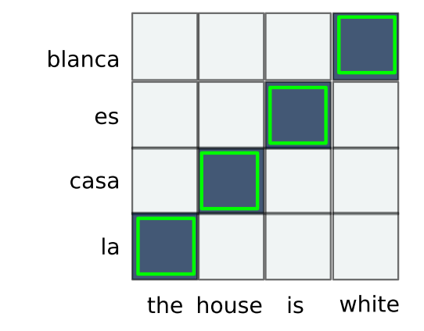
Phrase Extraction (up to length 4)
the | la
house | casa
is | es
white | blanca
the house | la casa
house is | casa es
is white | es blanca
the house is | la casa es
house is white | casa es
blanca
the house is white | la casa
es blanca

Slide 39
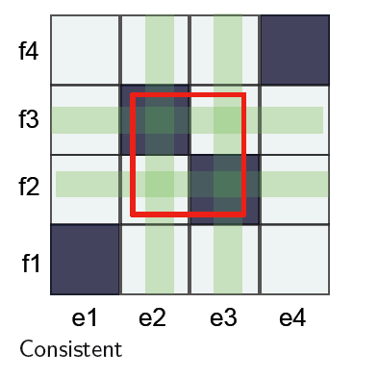
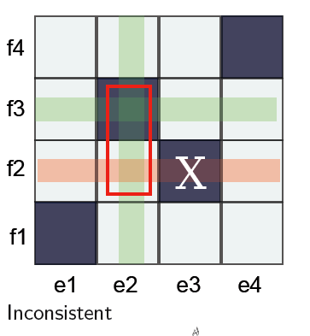
Consistency

Slide 40
The effect of alignments in PX
Objective: determine which characteristic was more relevant
Quality?
Structure?
Analyzed different types of Chinese – English
Discriminative (DWA-1,DWA-2, … , DWA-9)
Generative (GIZA- S2T, GIZA- T2S)
Heuristic (SYM)
Diversity of balance precision/recall between alignments.
Notes:
----- Meeting Notes (11/23/11 00:24) -----
rework analyzed

Slide 41
Alignment Density metrics
Literature
Ours
Avg. number of links
Avg. Number of source and target gaps
Gap rates
Notes:
----- Meeting Notes (11/23/11 22:44) -----
Besides quality, we measured alignment structure.
We used the number of links, which had been previously used
which is the average number of links in an alignment set
And we propose to use alignment gaps as a measure of density (sparseness)
In this formula, l(i,j) is an indicator function, of a link at position i,j in the alignment matrix. What this formula is doing is counting the number of rows /or columns in our alingment matrix that are left unaligned.
An then average that quantity by the number of alignments in the set.

Slide 42
What do we mean by gaps?
Alignment matrix
In this phrase pair: 1 gap on the target phrase
In this phrase pair: 2 gaps on the source phrase
Notes:
----- Meeting Notes (11/23/11 22:44) -----
one further

Slide 43
Phrase- pair metrics
Quantitative
Number of phrase pairs
Singletons (unique entries)
Phrase length
Gaps (unaligned words inside phrase pair)
Quality
Manual Evaluation
Notes:
----- Meeting Notes (11/22/11 00:14) -----
ppairs
----- Meeting Notes (11/23/11 00:24) -----
PPairs metrics

Slide 44
Number of Phrases
PT grows as our alignment gets sparser
Related to unaligned words rather than number of links
Notes:
----- Meeting Notes (11/23/11 22:44) -----
One of the main observations we made is that the less links we have in our alignment, the more phrase-pairs are generated.
On the x axis observe the diferent types of alignemnts used.
In this graph, on the left axis, we observe the total number of links in the alingments

Slide 45
Number of Phrases
PT grows as our alignment gets sparser
Related to unaligned words rather than number of links

Slide 46
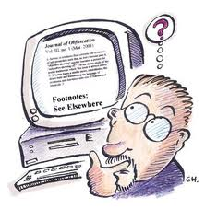
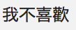
Human Evaluation of Phrase Pairs
Setup:
Bilingual Chinese-English Speakers
Each subject was asked whether a phrase pair was adequate
No contextual information
Included a noisy input
YES
NO
Notes:
----- Meeting Notes (11/22/11 00:14) -----
Next, different alignments

Slide 47
Results
Most dense alignments fare better.
Gaps 3 times more errors for Hand Aligned data
Random pairings are usually bad

Slide 48
Summary
High precision alignments
More phrase pairs
More coverage
More unique phrase pairs
More TM sparity
More gaps
Less links
Longer phrases
Use less phrases
More gaps in phrases
Lower quality phrase pairs

Slide 49
Word alignments and TM
Preprocessing
Word Alignments
Phrase Extraction
Translation Model
Notes:
----- Meeting Notes (11/10/11 13:25) -----
Amarillo no se nota bien

Slide 50
Going further: Translation Model
More than just phrase-pairs
Translation probability features
Phrasal phi(e|f) (PT1)
Lexical lex(e|f) (PT2)
Inverse phrasal phi(f|e) (PT3)
Inverse lexical lex(f |e) (PT4)
Estimated using MLE
Notes:
----- Meeting Notes (11/23/11 10:38) -----
Phrasal

Slide 51
A phrase-table example

Slide 52
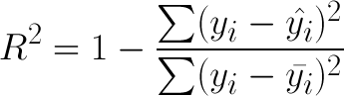
Predicting TM characteristics
Setup
Different alignments
Resampling
Tested on unseen Es-En, Ar-En, Ch-En
Methodology
Get best model, using multivariate linear regression
Report R² on unseen data

Slide 53
Variables
Alignment
Phrase-table (TM)
Quality
F-measure, Precision Recall
Structure
Density: Links, Gaps
Distortion: Crossings, Rel. Distortion, Diagonality.
Entries
Number of entries
TM Features
Average entropy
Alignment
Density
Distortion
Phrase-length
Notes:
----- Meeting Notes (11/22/11 00:14) -----
Need to introduce F-measure, etc
Dimension, out

Slide 54
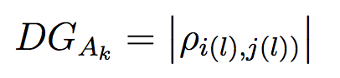
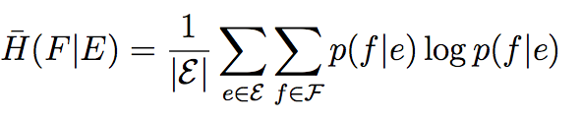
New variables
Literature
Ours
Alignment distortion
Rel. distortion
Crossings
Translation model
Phrase Length
Entries
Alignment distortion
Diagonality
Translation model
Avg. feature entropy

Slide 55
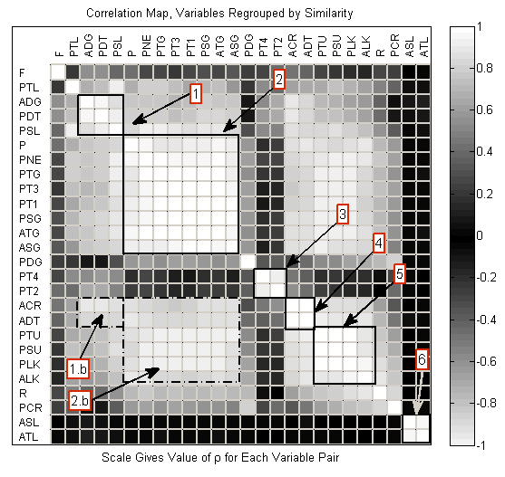
Notes:
----- Meeting Notes (11/22/11 00:14) -----
Defin what to say
We need to say more about the models

Slide 56
Number of entries
PNE
Target gaps
Link density
Diagonality
Notes:
----- Meeting Notes (11/22/11 00:14) -----
Explain R2

Slide 57
Phrasal Entropy (phi)
Inv. Phi (f|e)
Source Gaps
Phi (e|f)
Target gaps
Notes:
----- Meeting Notes (11/22/11 00:14) -----
put features in table

Slide 58
Lexical Entropy (lex)
Inv Lex (f|e)
Diag.
Lex (e|f)
Diag.
Notes:
----- Meeting Notes (11/22/11 00:14) -----
put features in table

Slide 59
Model summary
Links
TM Size
Coverage
Gaps
Phrasal Entropy
More TM sparsity
Diag.
Source Phrase Length
Use less phrases
Lexical Entropy
More TM sparsity

Slide 60
Summary
Alignment structure has impact of the translation model
Most of the translation model features can be predicted knowing the alignment characteristics
Size of phrase-table
Average length
Phrasal feature entropy
Most relevant alignment characteristics
Links
Gaps
Diagonality

Slide 61
This talk outline:
0 -Motivation
3- The translation model and translation quality.
1- Word Alignments and SMT
· Quality discrepancy
· Partial explanations
· Hypothesis and objectives
4- Improving SMT using alignment structure
2- Alignments and the translation model
Conclusions
Notes:
Today, we will talk about a specific problem of Machine Translation.
Namely, the discrepancy between what is known as Alignment Quality and its cousin Translation Quality.
We will introduce related work, that has tried to address this problems
And we will introduce out hypothesis and the set of objectives for this dissertation
Next, we’ll have a closer look at the effect of alignments and the translation model
Followed by the effects of the translation model and tq
In the last part, we will propose several alternatives to improve machine translation using alignemtn structure
Finally we will provide a set of conclusions.

Slide 62
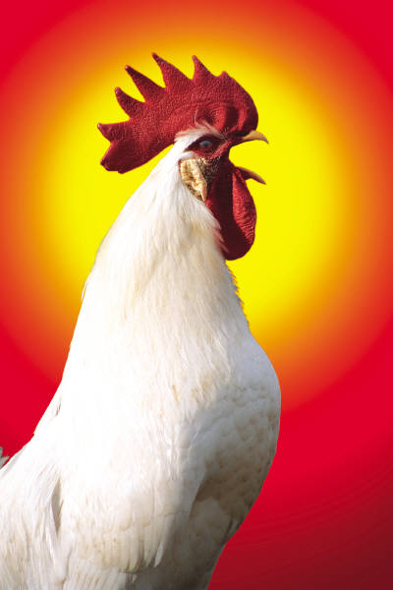

Are you still with me?

Slide 63
Predicting MT performance

Slide 64
Our goal
To investigate which features from our PT (special focus on alignment) and first best translations help to predict translation quality (BLEU, METEOR, TER) score.
Build predictive multivariate regression models
Test robustness of our prediction models

Slide 65
Alignment structure vs. translation
No easy way to measure
Problem, TM is very large!
TM
decoder
input
Alignment Info
translation

Slide 66

Filter TM to input
Translation tasks
Doc 1
Doc 2
Doc N
Filtering
TM2
TM2
Translation Model
To analyze the available translation options at decoding time

Slide 67
Experimental Setup
7 Different types of alignments
DWA{4,5,6,7}
GROW-DIAG(-FINAL)(-AND)
Sampling from different document sets
Created small translation tasks (100 sentences each)
24 for En-Es train
8 for En-Es test
4 Different docs for Ar-En, Ch-En
Notes:
----- Meeting Notes (11/22/11 00:49) -----
Rework

Slide 68
Translation tasks
GROW-DIAG
Doc 1
Doc 2
Doc N
Filtering
DWA-4
1
GD1
GD2
PT Measurements
4
PT var2
2
Translation
Translation models
FB-GD2
FB Measurements
FB-GD1
FB var2
3
Evaluation
references
5
BLEU 2
MODEL
Doc 1
Doc 2
Doc N

Slide 69
Variables to measure
 | Phrase Table variable |  | First Best Hypotheses
Phrase Table entries | PSU | Src Unique (%)
 | PTU | Tgt Unique (%)
 | PNE | Number of entries
Alignment Density | PSG | Source Gaps | FSG | Source Gaps
 | PTG | Target Gaps | FTG | Target Gaps
 | PLK | Link density | FLK | Link density
Alignment Dimension | PSL | Source length | FSLP | Source length
 | PTL | Target length | FTLP | Target length
Alignment Distortion | PCR | Crossings | FCR | Crossings
 | PDG | Diagonality | FDG | Diagonality
 | PDT | Relative distortion | FDT | Relative distortion
Translation Model Features | PT1 | P(f|e) avg entropy | FT1 | P(f|e) avg cost
 | PT2 | lex(f|e) avg entropy | FT2 | lex(f|e) avg cost
 | PT3 | P(e|f) avg entropy | FT3 | P(e|f) avg cost
 | PT4 | lex(e|f) avg entropy | FT4 | lex(e|f) avg cost
Language Model |  |  | FLM | LM cost
Translation quality |  |  | BLEU | Bleu
 |  |  | MET | Meteor
 |  |  | TER | TER

Slide 70
Modeling issues
Specification
Many features to include. Which ones?
Estimation
Dealing with large number of features
Feature reduction
Feature selection
Regularization
Stepwise regression

Slide 71
Methodology
Stepwise Regression (Search)(Hair et al,2010)
Start with an empty base model
Build a regression model with each one of the possible predictors
Add the most significant predictor to the base model
Start over with the remaining predictors.
Continue until no other significant predictors can be added to the model.
At any time: Discard any predictor that becomes irrelevant after adding latest predictor.

Slide 72
RESULTS
General models
BLEU
METEOR
TER
Targeted for Easy translation tasks:
BLEU
METEOR
TER
Targeted for Hard translation tasks
BLEU
METEOR
TER

Slide 73
BLEU
High determination coefficient (>50%) even for unseen data.
Features helpful given language
Ar-En PT4, PT2, FLM
Ch-En PT4, PNE, PT2, FLM
Es-En (all)
BLEU
Entr. Inv. Lexical features
Entr. Lexical features
TM Size
Hyp. Target gaps
Hyp. LM Cost

Slide 74
Other metrics
METEOR
TER
Similar to BLEU
Lower percentage of variance explained (~40%)
Simpler model (no FLM)
Inverse coefficients
Harder to predict (~30%)

Slide 75
Summary
Predictive models for translation are language dependent
General models => Rely heavily on translation model
Entries
Lexical entropy
Targeted models => Rely on hypothesis characteristics
Language model
Translation costs
Target gaps = bad translations

Slide 76
Summary
Lexical entropy
Links
TM size
Gaps
Translation Quality
Inv. Lexical entropy
Diag.
Hyp. Target gaps
LM cost

Slide 77
Controlling the effects of structure
Links
TM size
Gaps
Translation Quality
Hyp. Target gaps

Slide 78
This talk outline:
0 -Motivation
3- The translation model and translation quality.
1- Word Alignments and SMT
· Quality discrepancy
· Partial explanations
· Hypothesis and objectives
4- Improving SMT using alignment structure
2- Alignments and the translation model
Conclusions
Notes:
Today, we will talk about a specific problem of Machine Translation.
Namely, the discrepancy between what is known as Alignment Quality and its cousin Translation Quality.
We will introduce related work, that has tried to address this problems
And we will introduce out hypothesis and the set of objectives for this dissertation
Next, we’ll have a closer look at the effect of alignments and the translation model
Followed by the effects of the translation model and tq
In the last part, we will propose several alternatives to improve machine translation using alignemtn structure
Finally we will provide a set of conclusions.

Slide 79
Improving Machine Translaton
Using Word Alignment Structure

Slide 80
At two different stages
At the alignment training stage:
Include more alignment gaps into the the training metrics
Preprocessing
Word Alignments
Phrase Extraction
Translation Model
At the translation model stage
Create new features that incorporate alignment gaps
Notes:
----- Meeting Notes (11/10/11 13:25) -----
Amarillo no se nota bien

Slide 81
Alignment Metrics
Traditional metrics focused on “positive links”
Precision
Recall
F measure
Our approach
Focus on positive null links.
Focus on positive and negative links.

Slide 82
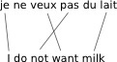
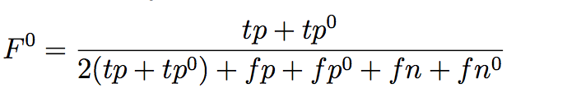
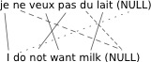
F⁰: Including gaps
We take into account gaps or null alignments into the computation of F-measure

Slide 83
Balanced Accuracy
Take into account the ‘true’ negatives
Balance between precision and specificity

Slide 84
Alignment Experimental Results
Tuning
200 training examples
Spanish English
Test
220 alignments
Spanish English
Systems
Baseline (DWA-F)
DWA-F0
DWA-BA

Slide 85
Alignment Structure
Target Gaps (avg)
Model Size(millions of entries)
Links (avg)

Slide 86
Translation Results
Notes:
Best results. Mostly due to a larger translation model.
Other metrics also reflect these results.
Training (Spanish- English)
Europarl, UN, News commentary. (WMT10 train)
About 8 Million training sentences.
----- Meeting Notes (11/22/11 13:14) -----
F

Slide 87
New metrics summary
Different tunings provide different results
Tuning towards F⁰ provides best results
Most precise alignment
Larger phrase-table
Best quality
Tuning towards BA provides most human-like structure
More compact alignments
Fewer translation options.

Slide 88
Alignment structure in translation
Target gaps were an indicator of bad quality.
Can we improve translation using that information?

Slide 89
Target Gap Feature
Include gap counts as a feature in translation model

Slide 90
Experimental Setup
7 Systems
4 Based on discriminative alignments (DWA-4, DWA-5, DWA-6, DWA-7)
3 Based on heuristic symmetrization (GD, GDF, GDFA)
Training (Spanish- English)
Europarl, UN, News commentary. (WMT10 train)
About 8 Million training sentences.

Slide 91
Experimental Setup
7 Different test sets (1 ref)
4 In-domain
Europarl Proceedings (WMT06,WMT07,WMT08)
Acquis Communautaire (AC)
3 Out of domain
News based (NW09, NW10, SC09)
Two settings
Baseline (canonical features)
+target gap feature
Total 15623 sentences (test time approx. 6hr decoding per system, multithreaded)

Slide 92
General results

Slide 93
Translation gains by task
Not so beneficial for
out of domain
Larger improvements for in-domain data

Slide 94
Translation gains by system
More Gaps
Less Gaps

Slide 95
T-gap feature summary
Improves translation estimation
In most cases, best translations system+gaps
Originally liability, gaps are turned to advantage
Target gap feature useful
When dealing with in-domain data
When we have more target gaps

Slide 96
Using limited training data
Use source and target gap features
Translate Ch-En data.
Different systems
DWA(0.1 -0.9), SYM
Test sets (4 refs):
News
Web blogs
Conditions
Baseline
System + gap features

Slide 97
News Test
Gap features yield best results

Slide 98
Web blogs
Larger improvements
2bp

Slide 99
T-gap + S-gap summary
Using both gaps can improve translation
Very useful in limited training
Chinese-English task up to 2BP of improvement

Slide 100

This talk outline:
0 -Motivation
3- The translation model and translation quality.
1- Word Alignments and SMT
· Quality discrepancy
· Partial explanations
· Hypothesis and objectives
4- Improving SMT using alignment structure
2- Alignments and the translation model
Conclusions

Slide 101
Conclusions

Slide 102
Revisiting hypothesis
Alignment structure has a large impact on how a translation model is estimated. Hence, it should also have a large impact on Machine Translation performance. Thus, by controlling the impact of alignment structure we will be able to improve Machine Translation performance.

Slide 103
Break apart
Alignment structure has a large impact on how a translation model is estimated
Yes, many features of the translation model can be determined knowing the alignment
Hence, it should also have a large impact on Machine Translation performance.
Yes, the size of translation model is a large contributor to quality. Also target gaps
By controlling the impact of alignment structure we will be able to improve Machine Translation performance
Yes, at two stages. Alignment training and TM features.

Slide 104
Objectives => Contributions
Analyze the impact of alignment structure at different stages of the training pipeline
Provide models that measure the impact of alignment structure in phrase-based translation model estimation
Provide a model that measure the impact of alignment structure and translation model in translation quality
Use alignment structure to better alignment training and better translation modeling to improve machine translation performance

Slide 105
Future Work
Couple new alignment metrics + new decoding features
Interactions
Explore use of alignment distortion (e.g. diagonality) as decoding features
Explore other model specification alternatives
Use hierarchical models to model dependencies between AL => TM => TQ

Slide 106
END

Slide 107
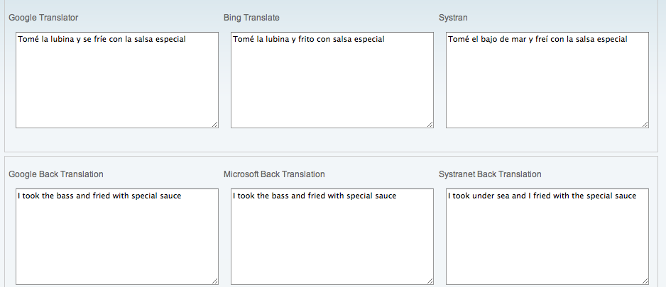
I took the sea bass and fried it with the special sauce
Tomé la lubina y la freí con la salsa especial
http://www.1-800-translate.com/machine_trans
http://www.ackuna.com/badtranslator
http://translationparty.com/

Slide 108
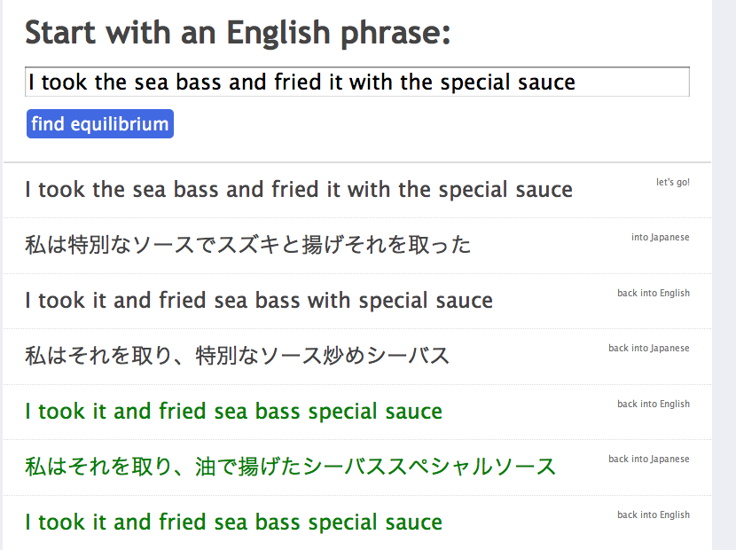

Slide 109
Publications

Slide 110
References

Slide 112
Stop criteria
Suggested conservative thresholds (Hair, 2010)
Partial F-statistics
P-value enter: 0.01
P-value out: 0.05
Yield most compact models
Also to block against spurious effects (capitalization by chance), high collinearity, we repeated procedure blocking original variables, and checking on a Spanish CV set.
F[N-1,N-n-1]=(1-R²)(N-p-1)
(1-R’²)(N-p-2)

Slide 113
BLEU: Translation Quality
Bi Lingual Evaluation Understudy.
Widely used.
Ranks from 0 to 1.
Compares n-grams from the candidate translations with the references translations.
Precision oriented.
Brevity penalty (to avoid too short translations).
Ranges of acceptable BLEU differ depending on the task.
Notes:
----- Meeting Notes (11/23/11 22:44) -----
before?

